Slide 1
Causal Loop Diagrams – part 2 Visualising connections between parts of systems
Freya Ivy Palmer, Avanthika Kamath, Imali Manikarachchige, Craig Hutton
Full resource, see: https://www.ncrm.ac.uk/resources/online/all/?id=20845

Slide 2
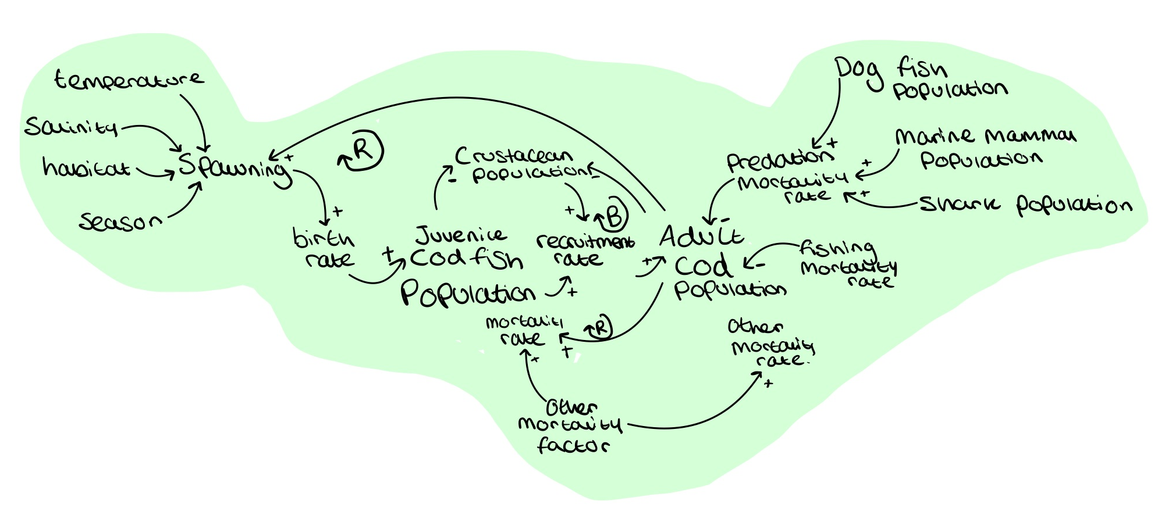
Expanding the CLD – Environmental pillar
Notes:
Green one from previous pres
This is one pillar of sustainability (environmental) need to consider social, economic, and regulations…. And causalities

Slide 3
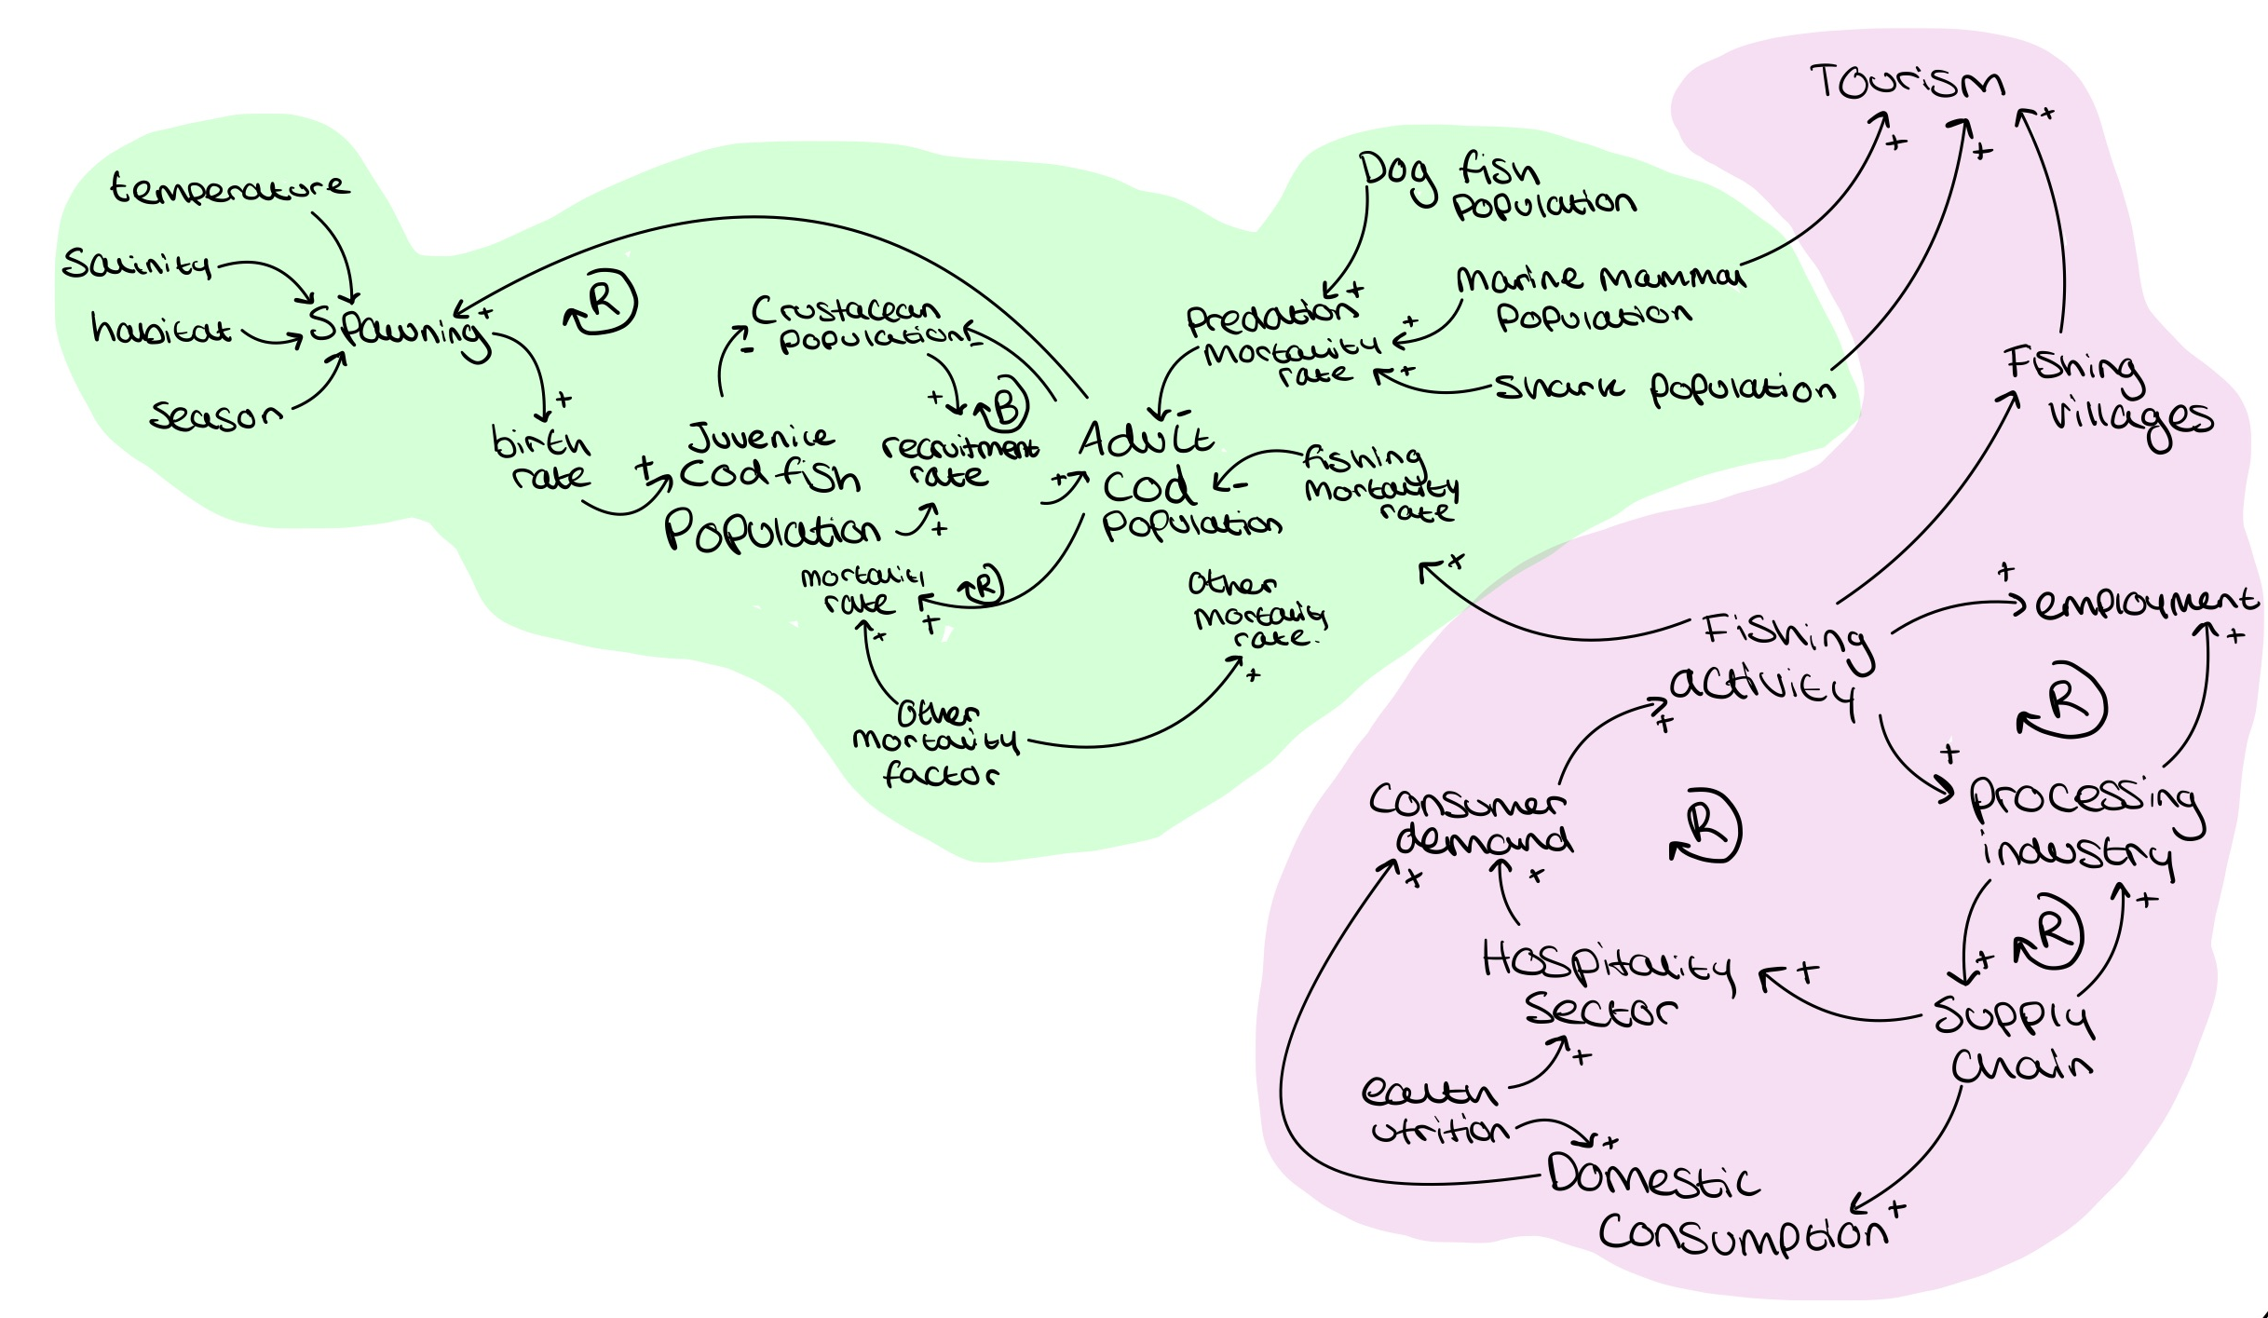
Expanding the CLD – Social pillar
Notes:
Green one from previous pres
This is one pillar of sustainability (environmental) need to consider social, economic, and regulations…. And causalities

Slide 4
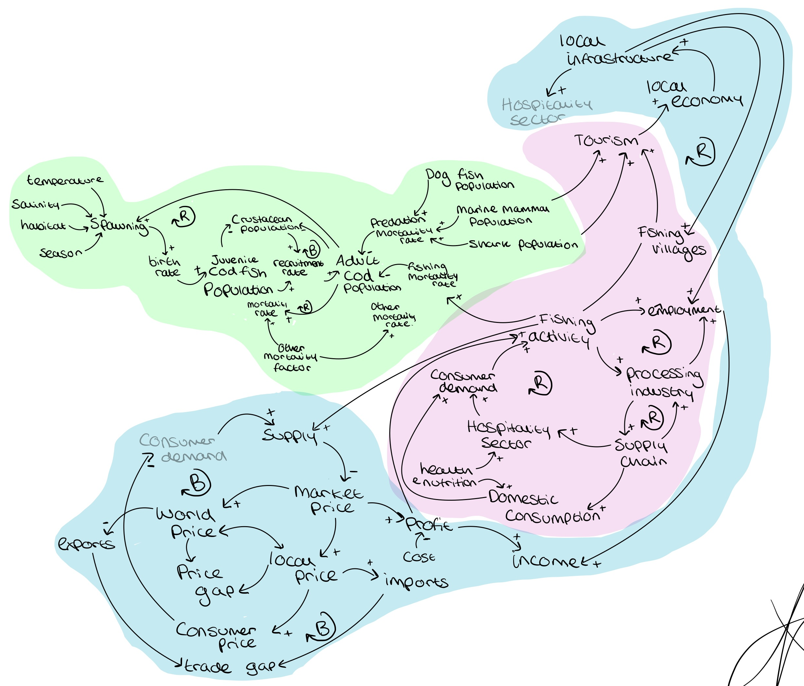
Expanding the CLD – Economic pillar
Notes:
Green one from previous pres
This is one pillar of sustainability (environmental) need to consider social, economic, and regulations…. And causalities

Slide 5
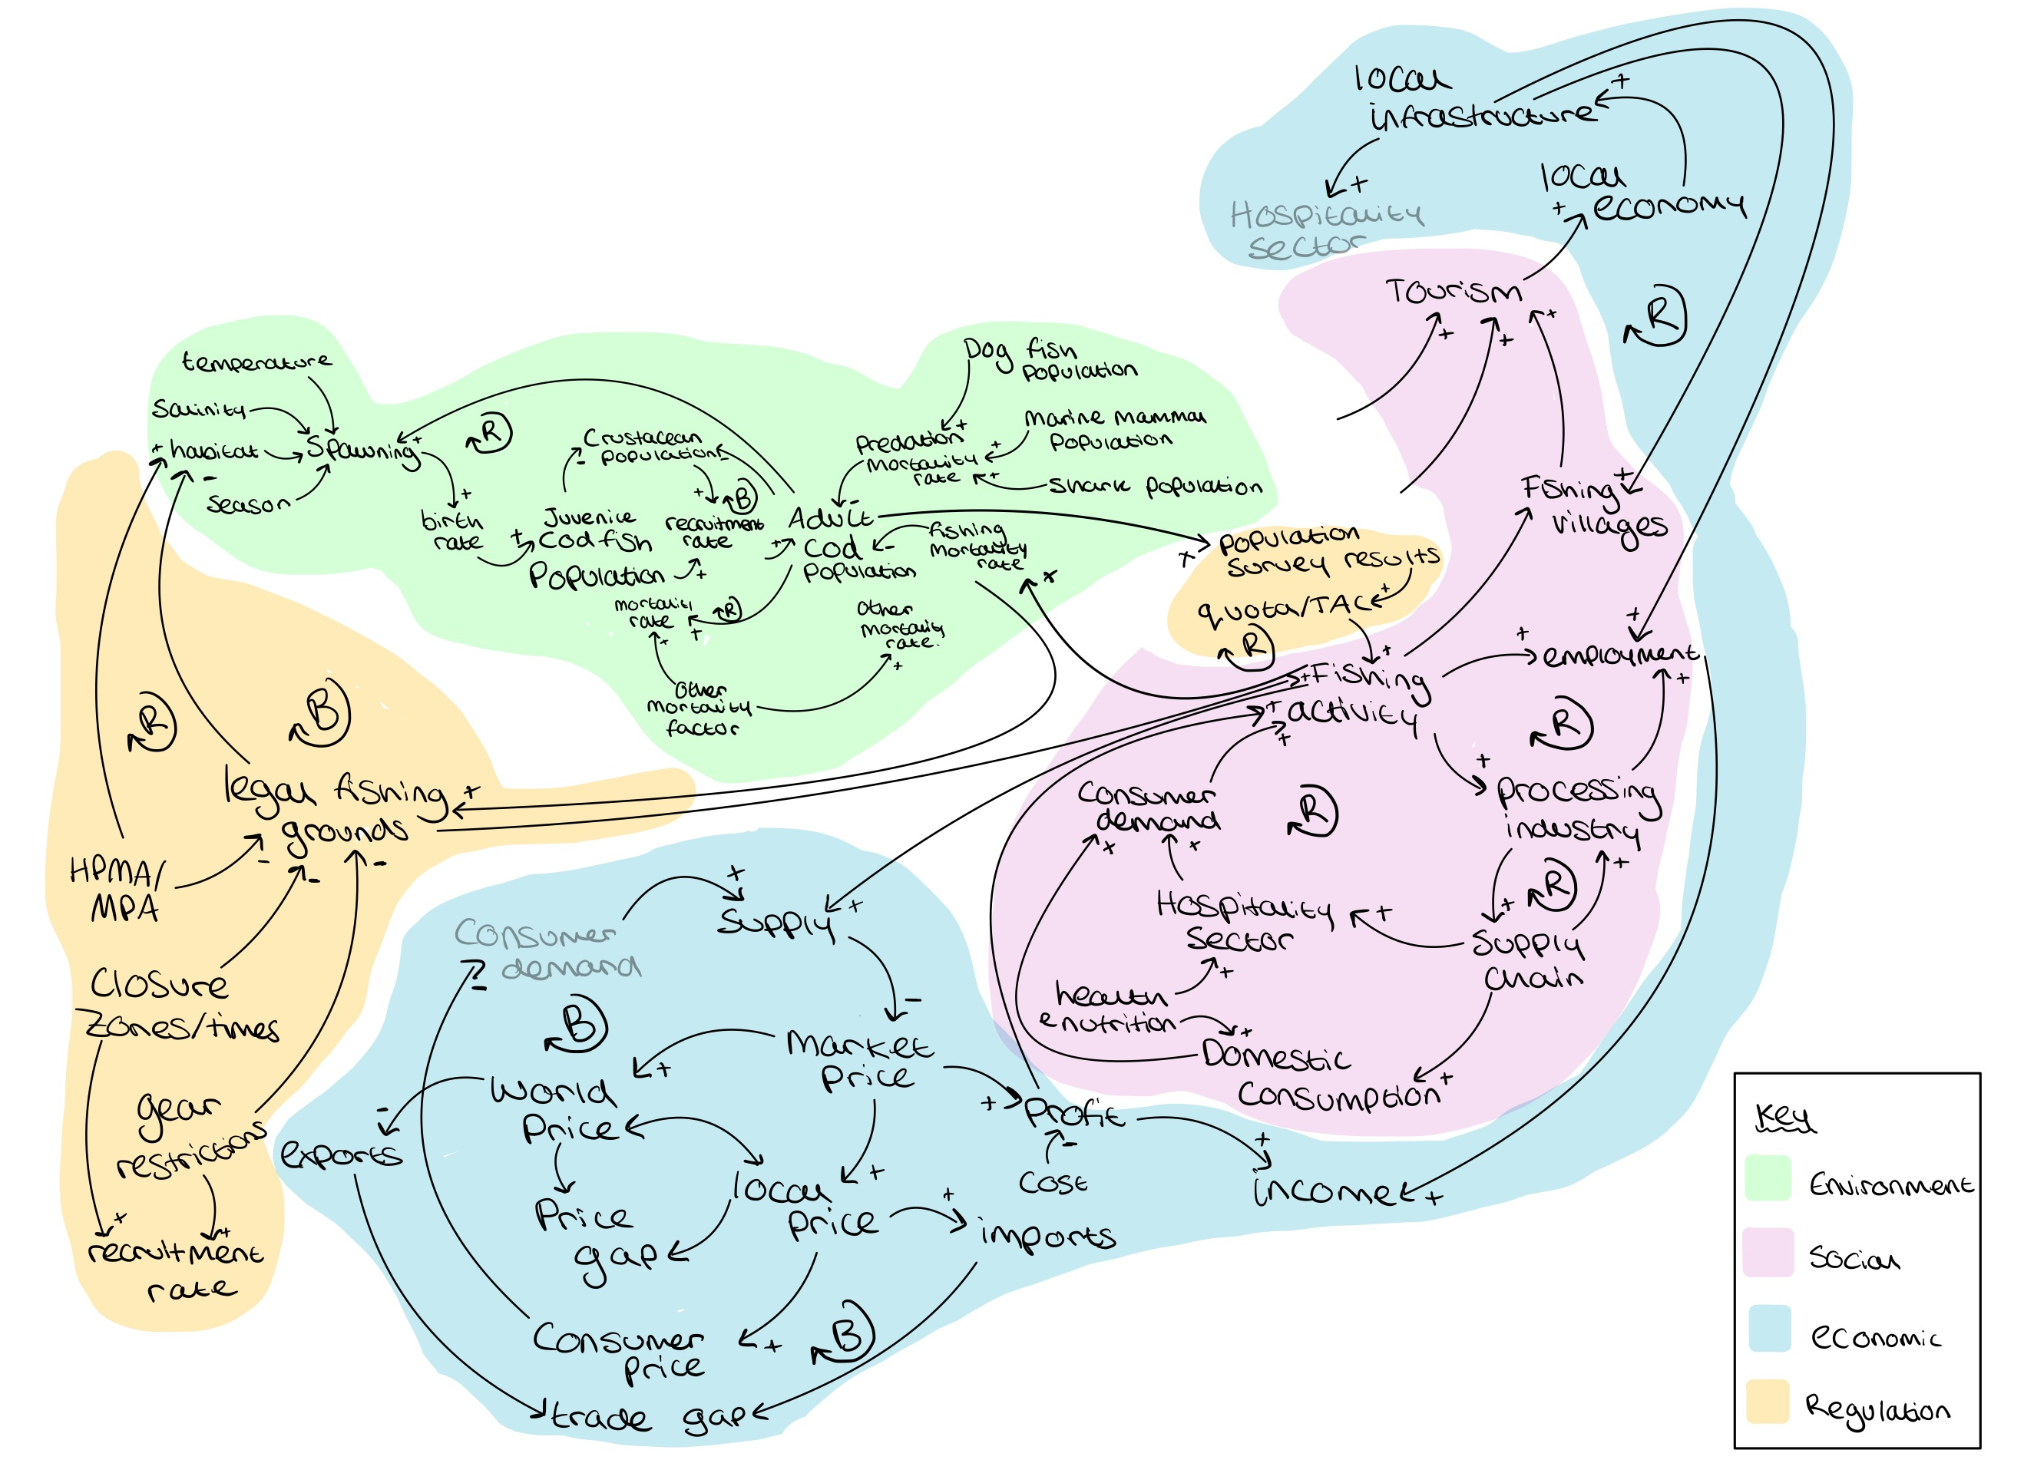
Expanding the CLD – Regulation
Notes:
Green one from previous pres
This is one pillar of sustainability (environmental) need to consider social, economic, and regulations…. And causalities

Slide 6
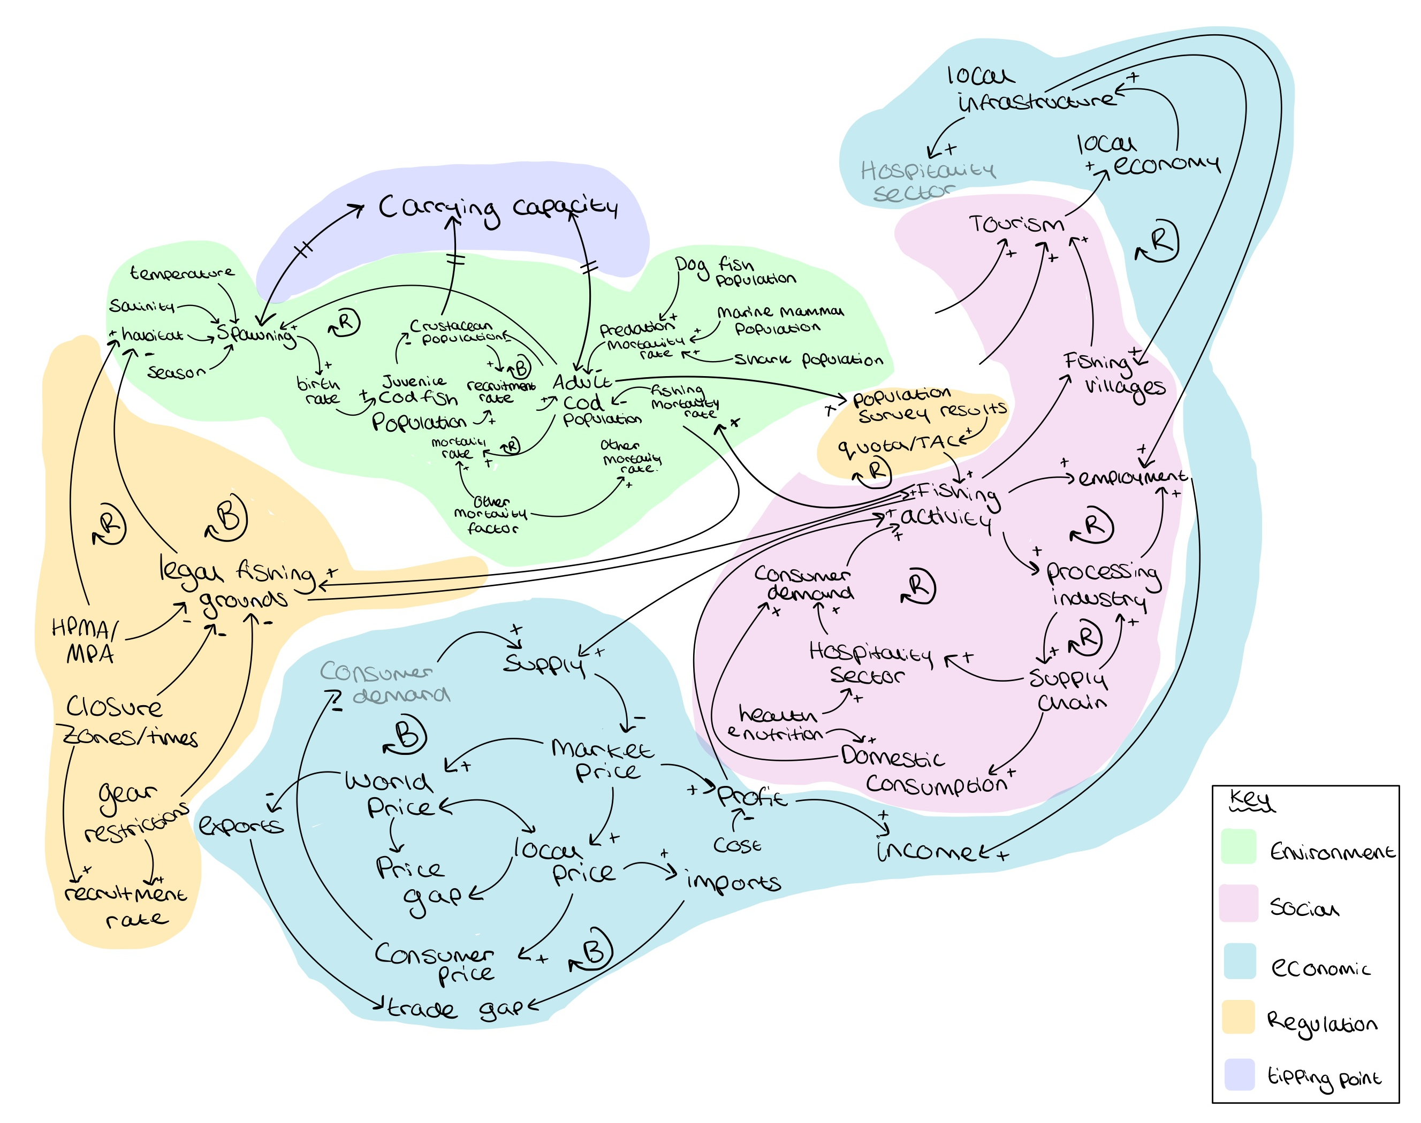
Expanding the CLD – Tipping point
Notes:
Tipping point which is carrying capacity – this is the result of the reinforcing feedback which may occuor when fishing activity is sooo high that the cod population takes a hit and decreases by a loarge amountt once it reaches a threshold the carrying capacity is changes.

Slide 7
Reflecting on a CLD building process
Positives
Considerations
Can make better informed choices
Can involve stakeholders in the CLD design process
Useful for interdisciplinary projects – can categorise qualitative data
Systems can get messy
Iterative process
Can be subjective to creator of the CLD
Making process can be more informative than the final diagram
Can be hard to verify the significance of connections
Notes:
Deeper understanding
Can engage with stakeholders to show the varying perspectives within a systems
Good for mixed/multi method based projects as the CLD connections can be supported by qualitative and quantitative data
Boundaries are ended relatively early on a systems can get very messy very quickly – they are made iteratively each time getting clearer on the boundaries and what variables/connections answer the problem in question
Can be subjective to persona nd time that the CLD is created, systems can change relatively quickly.
The making process is more informative that the final product – why it can be nice to engage with various stakeholders in the design process (if not being done as a literature/scoping tool)

Slide 8
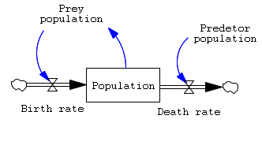
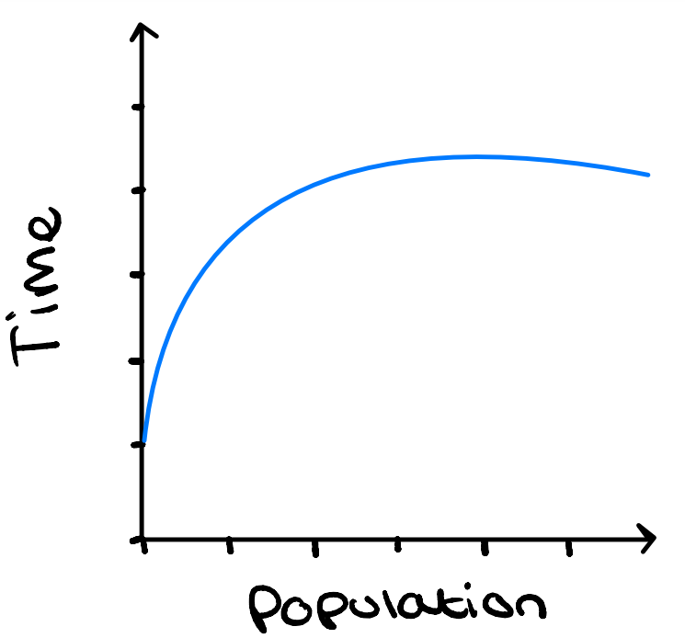
Possible further advancements
System dynamic modelling
Behaviour over time graphs
Simulation test
Notes:
Can take the CLD model further by making in systems modelling software's where you can add data and equations to the variables and connections respectively to produce a model. You can input data into these models or just create based on assumptions
These models create BOT graphs which can show how the measurable variable (stock) varies over time.
This can allow to simations to be performed where you can see how changes to the overall system can impact the stock to produce a better or worse outcome over time

Slide 9
www.ncrm.ac.uk

